Slide 1
2.1 Rapid estimates using Structural time series models
Dr. Pim Ouwehand
October 2026

Slide 2
Overview:
Introduction to stm’s
  in-sample and out-of-sample forecasting
    Exercises
  out-of-sample with regressors: nowcasting
    Exercises

Slide 3
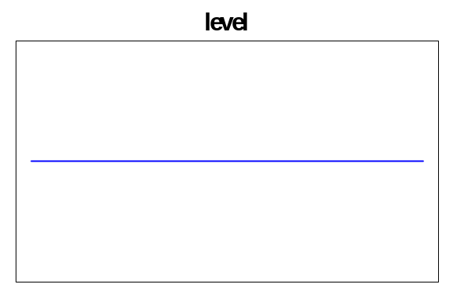
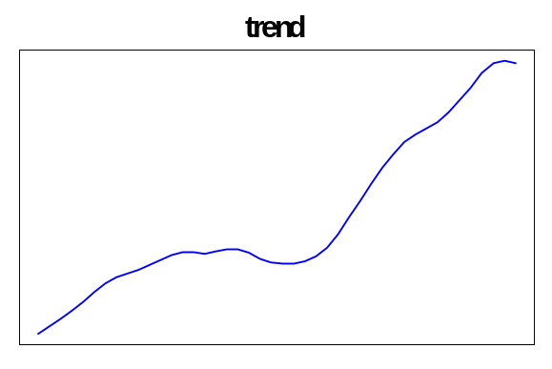
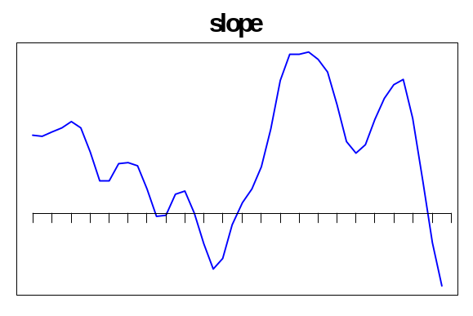
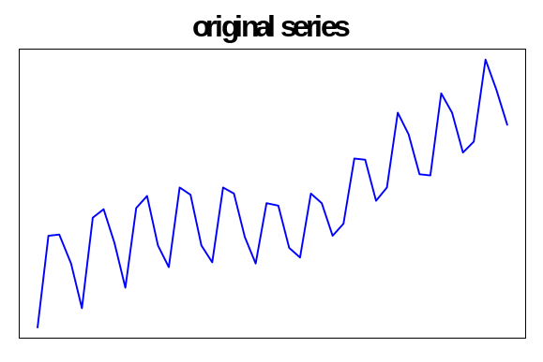
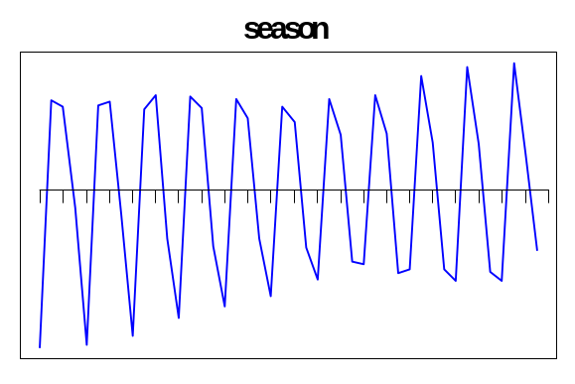
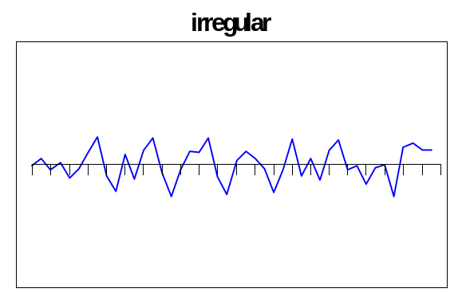
Time series decomposition

Slide 4
Structural times series model (STM)
Objective : describe underlying patterns in data explicitly
Signal vs. Noise
Series = Signal + Noise
Signal = Trend + Seasonal + …

Slide 5
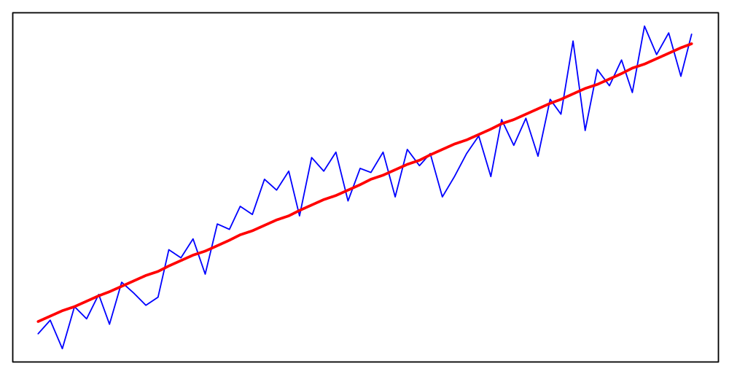
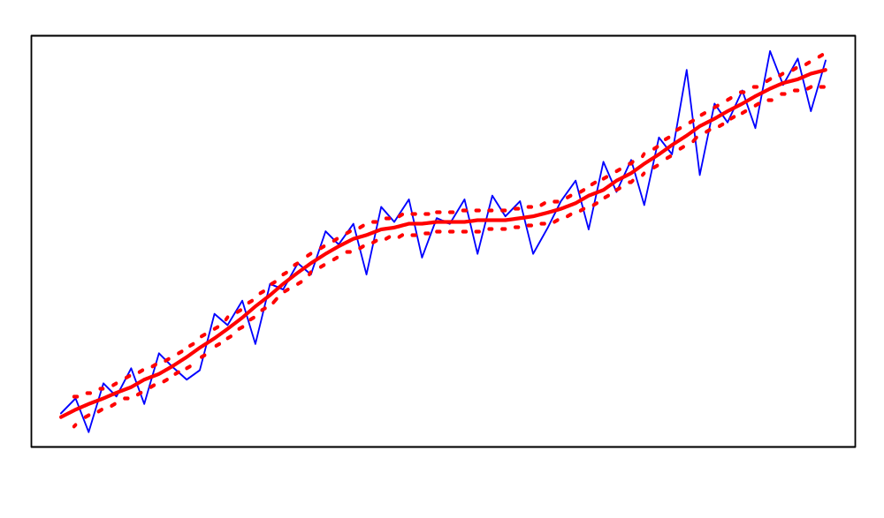
What is a trend?
Underlying long term growth rate
Global Local (with margins)
STM: time series components vary over time

Slide 6
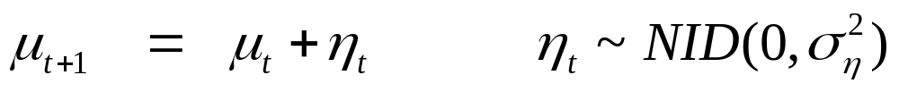

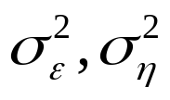
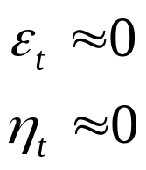
STM (random walk plus noise)
signal
noise
: level (state variable), unobserved
: hyperparameters, determine noise and evolution of level
: random walk
: stationary line
Measurement eq.
Transition eq.

Slide 7
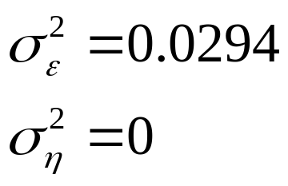
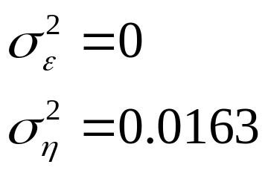
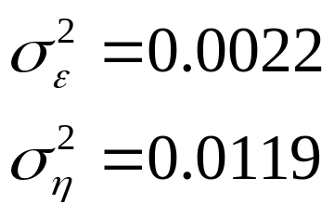
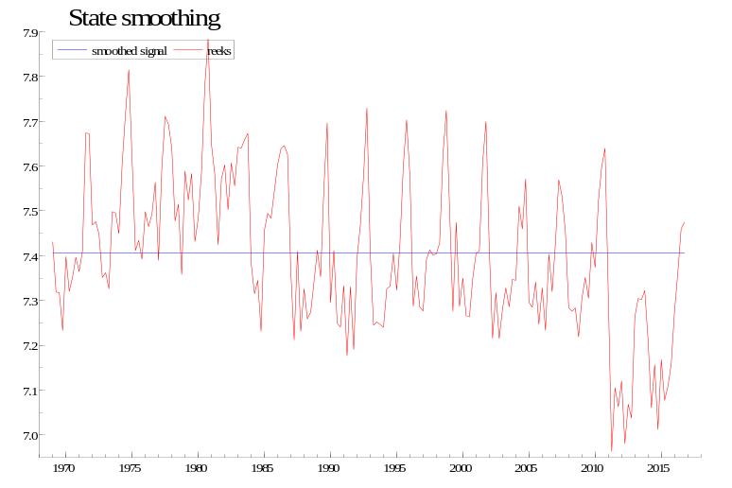
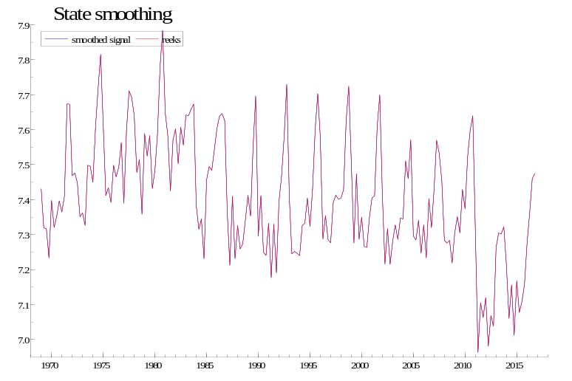
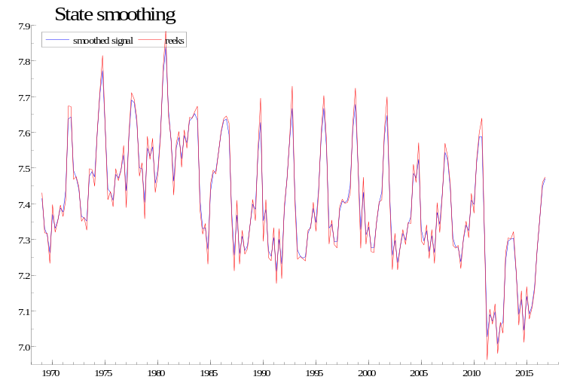
Estimates of signal

Slide 8
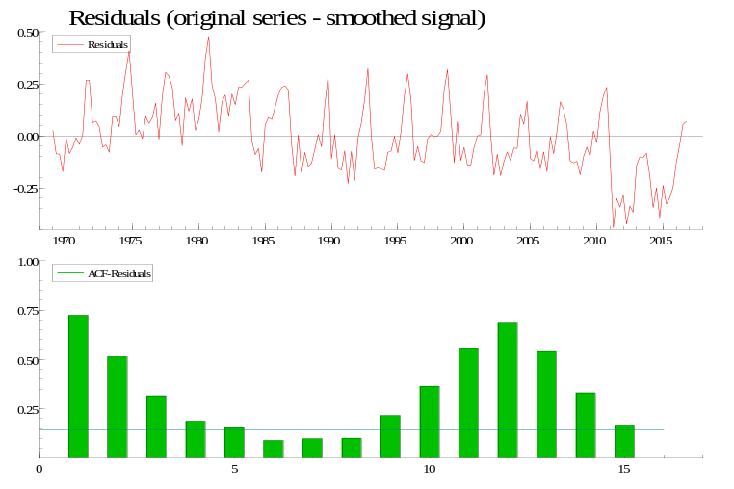
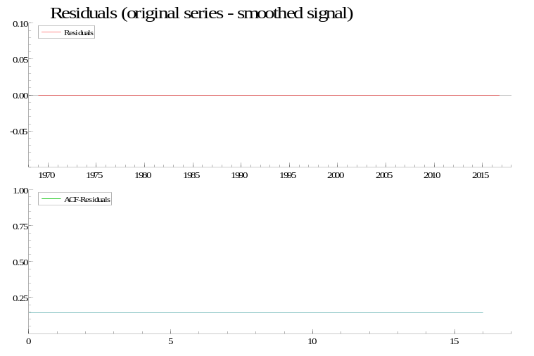
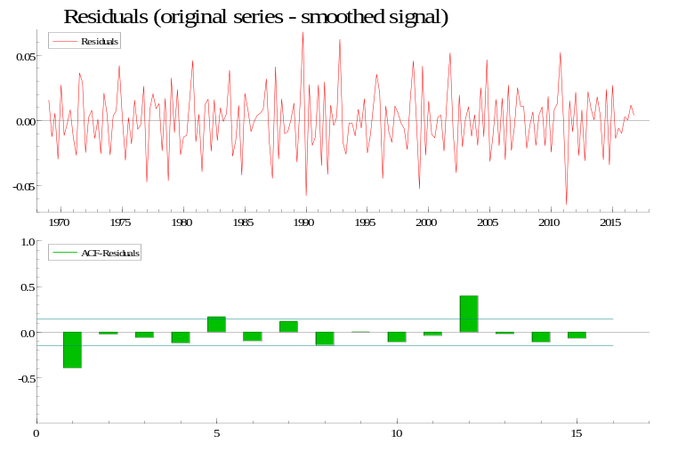
Residuals
Residuals

Slide 9
Residuals
Autocorrelation (Q): 415.21 83.94 105.40
Heteroscedasticity (H): 2.06 1.05 1.06
Normality (N): 0.73 11.07 13.24
Q<23.6? , H< 1.43?, N<5.99?

Slide 10
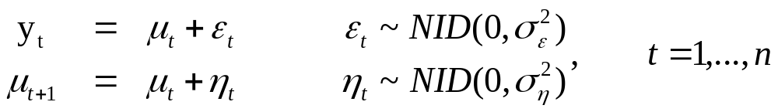
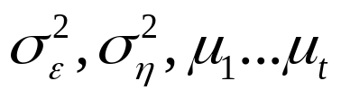

Estimation of parameters
Known:
Unknown:
$$y_{t}$$
1. Estimate hyperparameters
  - Maximise Likelihood function
  - Likelihood-function may have local optimum
  - Outcome depends on starting conditions
2. Estimate states (Kalman filter):
  Recursive algorithm,
  iterates forward through series (filtering), and then
  backwards (smoothing) for estimation of time series components

Slide 11
Extensions

Slide 12
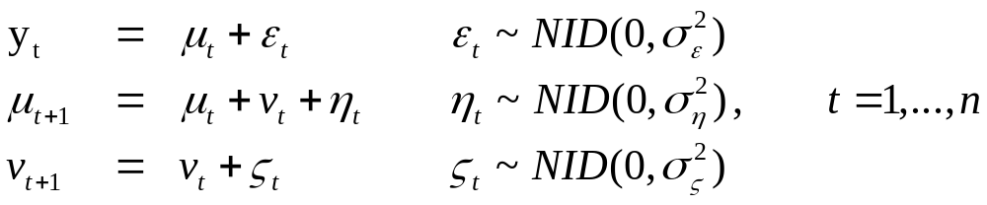
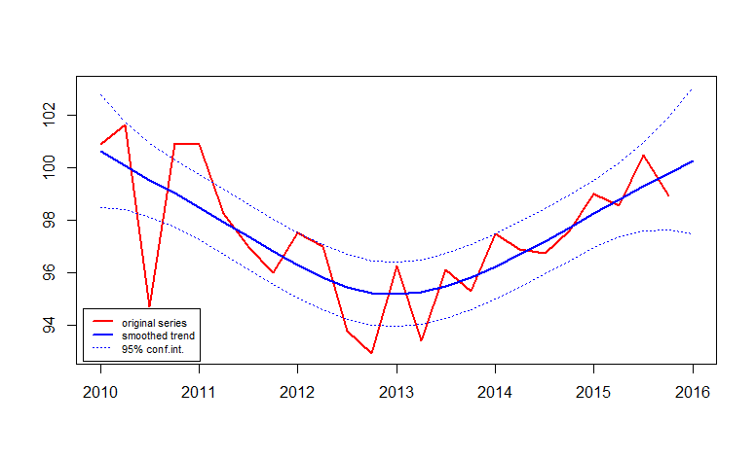

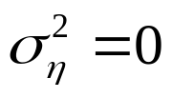
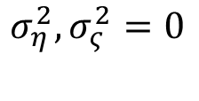

Model with trend (local linear trend)
: slope
: trend
: smooth trend model
: linear regression
$$μ_{t}+v_{t}$$
$$σ_{η}^{2},σ_{ς}^{2}=0$$

Slide 13
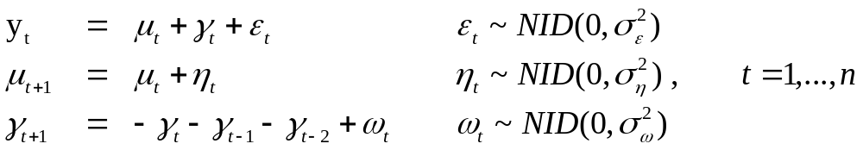
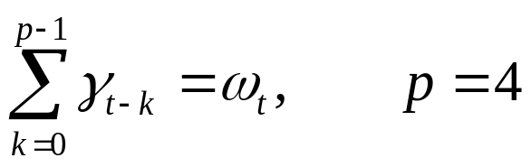
Model with seasonal

Slide 14
Models in R:
Total of 15 models in ‘compare.models(…)’
Level | Slope | Seasonal
Stochastic | -no- | -no-
Deterministic | Stochastic | Stochastic
 | Deterministic | Deterministic

Slide 15
How to select a model?
Good model:
  goodness-of-fit: low AIC
  significant (hyper)parameter estimates,
  model assumptions are satisfied.
  Parsimonious
    ‘small’ model: good explanatory value with smallest number of parameters possible
  vs.
    Overfitting
Noise itself is modelled. High in-sample explanatory value, but low predictive power.

Slide 16
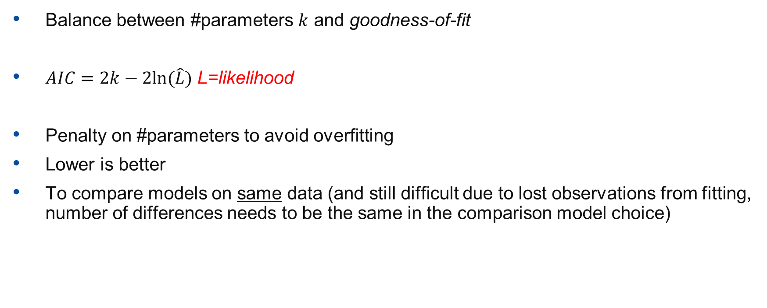
Akaike Information Criterion (AIC)
Balance between #parameters $k$ and goodness-of-fit
$AIC=2k−2ln⁡(\hat{L})$ L=likelihood
Penalty on #parameters to avoid overfitting
Lower is better
To compare models on same data (and still difficult due to lost observations from fitting, number of differences needs to be the same in the comparison model choice)

Slide 17
How to select a model in practice (manually)?
Good model: low AIC (Akaike Information Criterion), significant parameter estimates, no overfitting, model assumptions are satisfied.
Steps:
Obtain Maximum Likelihood estimate, optimise initial values
Choose model with lowest AIC
Check if hyperparameters are significant and not too small
overfitting, deterministic or stochastic component
Check assumptions
  Autocorrelation, Homoscedasticity, Normalitity of residuals
Do a visual check
Try other model (second lowest AIC)
Optional: Perform Likelihood ratio test

Slide 18
Example: STM in R
Code based on KFAS package : https://cran.r-project.org/web/packages/KFAS/
Summary: AIC's per model
model_nr AIC model_name
1 113.5490 det. level
2 107.4366 stoch.level
3 118.5753 det. level + det. slope (= classical regression)
4 110.4676 stoch.level + det. slope
5 108.2204 det. level + stoch.slope (=smooth trend)
6 110.2217 stoch.level + stoch.slope
7 112.6724 det. level + det. seasonal
8 106.1023 stoch.level + det. seasonal
9 109.2298 stoch.level + det. slope + det. seasonal
10 106.6872 det. level + stoch.slope + det. seasonal (smooth trend + seas)
11 108.6881 stoch.level + stoch.slope + det. seasonal
12 104.9493 stoch.level + stoch.seasonal
13 108.1476 stoch.level + det. slope + stoch.seasonal
14 105.3521 det. level + stoch.slope + stoch.seasonal (smooth trend + seas)
15 107.3533 stoch.level + stoch.slope + stoch.seasonal

Slide 19
model = 11 [1] "stoch.level + stoch.slope + det. seasonal"
value
LogLik -46.34405
AIC 108.68809
with: q = 5 (#diffuse states) w = 3 (#hyp.par)
parameter estimates:
sigma sigma^2 t-value
meas 1.56037935 2.4347837063 2.5387437
level 0.02607367 0.0006798365 0.1546449
slope 0.24781126 0.0614104182 2.8623307

Slide 20
model = 10 [1] "det. level + stoch.slope + det. seasonal (smooth trend + seas)“
value
LogLik -46.3436
AIC 106.6872
with: q = 5 (#diffuse states) w = 2 (#hyp.par)
parameter estimates:
sigma sigma^2 t-value
meas 1.5604152 2.43489563 2.539414
slope 0.2478813 0.06144512 2.863437

Slide 21
----Diagnostics summary:----
Statistic Value Critical_value Assumption_satisfied
Independence Q(10) 4.665 16.919 +
r(1) -0.012 +/-0.4 +
r(4) -0.142 +/-0.4 +
Homoscedasticity 1/H(7) 6.129 4.995 -
Normality N 9.066 5.991 -

Slide 22
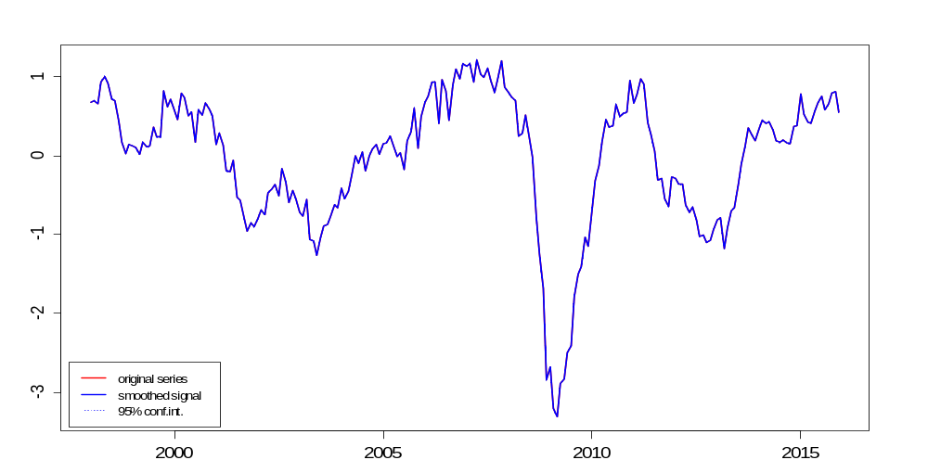
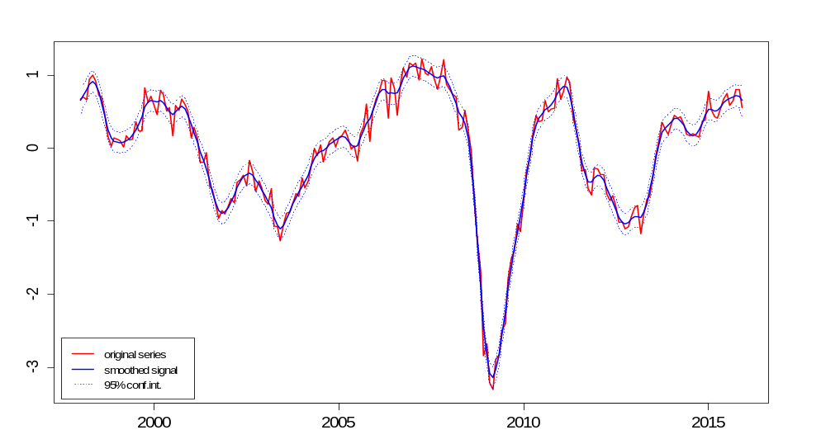
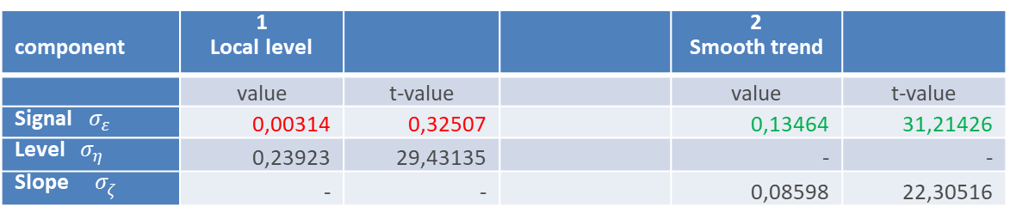
Overfitting – and what does that mean?
component | 1 Local level |  |  | 2 Smooth trend
 | value | t-value |  | value | t-value
Signal $σ_{ε}^{}$ | 0,00314 | 0,32507 |  | 0,13464 | 31,21426
Level $σ_{η}^{}$ | 0,23923 | 29,43135 |  | - | -
Slope $σ_{ζ}^{}$ | - | - |  | 0,08598 | 22,30516

Slide 23
Which components to include?
Everything with |t-value| >1.96
If you do not include it, it will be absorbed by other time series components
Interaction: if you do not include certain effects, they may be marked as an outlier, which causes other values (not) to be marked as outlier.
Think about parsimoniousness/overfitting (AIC)

Slide 24
Exercises

Slide 25
A nowcast for two sectors
Problem: no data sources available for publication period
Current approach: flash estimate = growth rate of previous quarter, possibly adjusted based on expert knowledge (‘naive method’)
Data:
  Quarterly data Banking and Insurance sectors
  Auxiliary variables (stock exchange transactions, mortgages, debit card payments, insurance policies, …)

Slide 26
R-script:
2.1_NowcastingSTM_part1.R

Slide 27
Nowcasting with STM’s

Slide 28
Time series models
Series = trend + cycle + seasonal + breaks + outliers + …. + noise
$y_{t}=τ_{t}+c_{t}+s_{t}+w_{t}+δ_{t}+θ_{j}+…+ε_{t}$, t=1,…,T

Slide 29
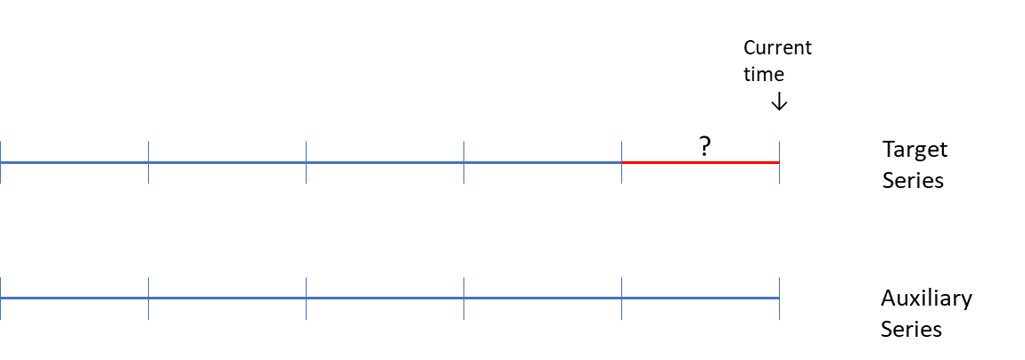
From forecasting to nowcasting
Use of auxiliary series:
Via regressor
  If they give a partial explanation of target series
In a simultaneous (bi-, multivariate) model
  If they have a common time series component

Slide 30

Model with explanatory variabele
$\begin{matrix}y_{t} & = & μ_{t}+\sum_{j=1}^{k}{β_{jt}x_{jt}+ε_{t}} & ε_{t}\sim NID\left(0,σ_{ε}^{2}\right) \\ μ_{t+1} & = & μ_{t}+η_{t} & η_{t}\sim NID\left(0,σ_{η}^{2}\right) \\ β_{jt} & = & β_{jt−1}+ρ_{jt} & ρ_{jt}\sim NID\left(0,σ_{ρ}^{2}\right) \\ ⋮ & & & \end{matrix}$, $t=1,…,n$
  : regressors, outliers, breaks

Slide 31
Example: bivariate model
$$\left(\begin{matrix}y_{1,t} \\ y_{2,t}\end{matrix}\right)=\left(\begin{matrix}μ_{1,t} \\ μ_{2,t}\end{matrix}\right)+\left(\begin{matrix}ε_{1,t} \\ ε_{2,t}\end{matrix}\right) ε_{t} \sim NID\left(\left(\begin{matrix}0 \\ 0\end{matrix}\right),\left(\begin{matrix}σ_{1,ε }^{2} & 0 \\ 0 & σ_{1,ε }^{2}\end{matrix}\right)\right)$$
$$\left(\begin{matrix}μ_{1,t+1} \\ μ_{2,t+1}\end{matrix}\right)=\left(\begin{matrix}μ_{1,t} \\ μ_{2,t}\end{matrix}\right)+\left(\begin{matrix}v_{1,t} \\ v_{2,t}\end{matrix}\right)+\left(\begin{matrix}η_{1,t} \\ η_{2,t}\end{matrix}\right) η_{t} \sim NID\left(\left(\begin{matrix}0 \\ 0\end{matrix}\right),\left(\begin{matrix}σ_{1,η}^{2} & 0 \\ 0 & σ_{2,η}^{2}\end{matrix}\right)\right)$$
$\left(\begin{matrix}v_{1,t+1} \\ v_{2,t+1}\end{matrix}\right)=\left(\begin{matrix}v_{1,t} \\ v_{2,t}\end{matrix}\right)+\left(\begin{matrix}ς_{1,t} \\ ς_{2,t}\end{matrix}\right)$ $ς_{t} \sim NID\left(\left(\begin{matrix}0 \\ 0\end{matrix}\right),\left(\begin{matrix}σ_{1,ς }^{2} & ρ_{ζ} σ_{1,ς} σ_{2,ς} \\ ρ_{ζ} σ_{1,ς} σ_{2,ς} & σ_{2,ς}^{2}\end{matrix}\right)\right)$

Slide 32
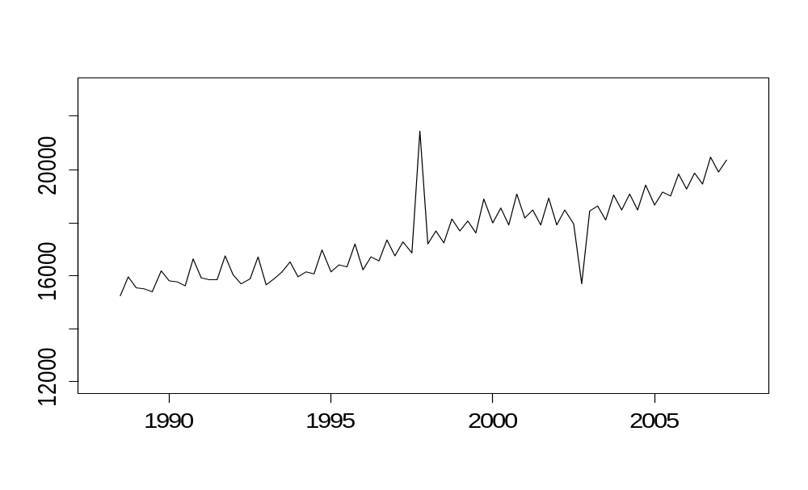
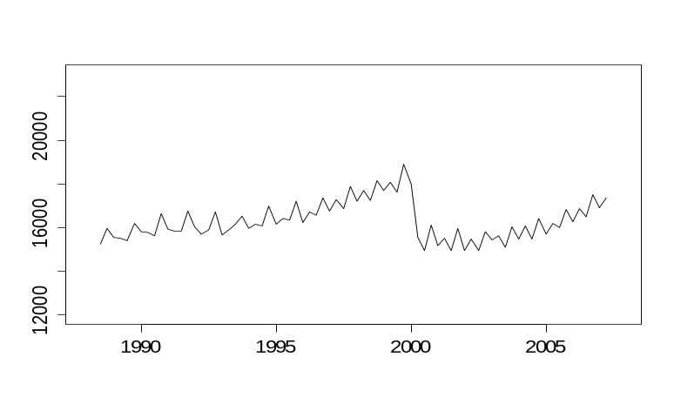
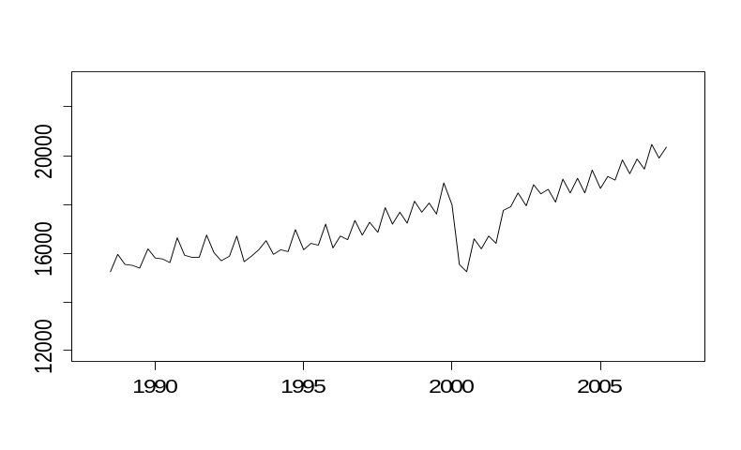
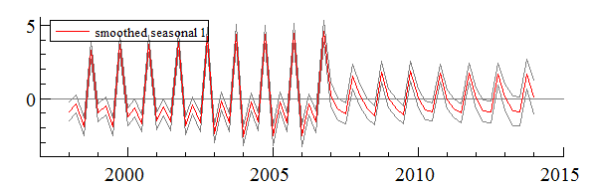
Outliers and breaks
Examples of
real world impacts
Change in tax reporting
Impact of COVID-19
Change in coverage
One-off impact, e.g. weather related
Additive outlier Level shift
Transitory change Seasonal break Ramp
0 1

Slide 33
Example additive outliers
trend

Slide 34
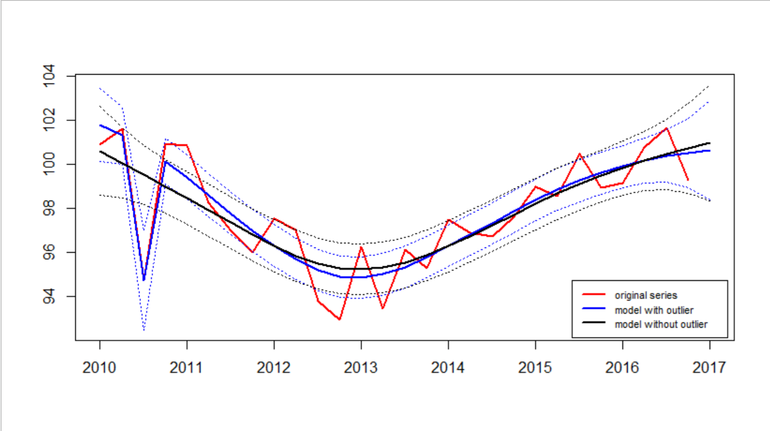
Example: additive outlier
Example: additive outlier

Slide 35
Example regressor creation
Level shift
Additive outlier
$$δ_{j,t}^{}=\left\{\begin{matrix}1 & for every period ≥t from the period in which the break occurs. \\ 0 & for all other periods \end{matrix}\right.$$
$$δ_{j,t}^{}=\left\{\begin{matrix}1 & for the period in which the outlier occurs \\ 0 & for all other periods \end{matrix}\right.$$

Slide 36
Period | Additive outlier | Level shift
2017 Q3 | 0 | 0
2017 Q4 | 0 | 0
2018 Q1 | 0 | 0
2018 Q2 | 0 | 1
2018 Q3 | 0 | 1
2018 Q4 | 1 | 1
2019 Q2 | 0 | 1
2019 Q2 | 0 | 1
2019 Q3 | 0 | 1
2019 Q4 | 0 | 1
2020 Q1 | 0 | 1
2020 Q2 | 0 | 1
2020 Q3 | 0 | 1
2020 Q4 | 0 | 1
Outlier creation

Slide 37
State space form
Univariate
Multivariate
$$\begin{matrix}\begin{matrix}y_{t} & = & {z^{′}}_{t}α_{t}+ε_{t} \\ α_{t+1} & = & T_{t}α_{t}+{R_{t}η}_{t}\end{matrix} & \begin{matrix}ε_{t} \sim NID\left(0,σ_{ε}^{2}\right) \\ { η}_{t } \sim NID\left(0,Q_{t}\right)\end{matrix} & \begin{matrix}\text{observation}\text{/}\text{measurement} \text{equation} \\ \text{transition}\text{/}\text{state} \text{equation}\end{matrix}\end{matrix}$$
$$\begin{matrix}\begin{matrix}y_{t} & = & Z_{t}α_{t}+ε_{t} \\ α_{t+1} & = & T_{t}α_{t}+{R_{t}η}_{t}\end{matrix} & \begin{matrix}ε_{t} \sim NID\left(0,H_{t}\right) \\ { η}_{t } \sim NID\left(0,Q_{t}\right)\end{matrix} & \end{matrix}$$

Slide 38
Example:
Local level model:
State space form:
With:
$$\begin{matrix}\begin{matrix}y_{t} & = & {z^{′}}_{t}α_{t}+ε_{t} \\ α_{t+1} & = & T_{t}α_{t}+{R_{t}ξ}_{t}\end{matrix} & \begin{matrix}ε_{t} \sim NID\left(0,σ_{ε}^{2}\right) \\ { ξ}_{t } \sim NID\left(0,Q_{t}\right)\end{matrix} & \end{matrix}$$
$$R_{t}=\left[\begin{matrix}1 & 0 \\ 0 & 1\end{matrix}\right]$$
$$Q_{t}=\left[\begin{matrix}σ_{η}^{2} & 0 \\ 0 & σ_{ζ}^{2}\end{matrix}\right]$$
$$ξ_{t}=\left(\begin{matrix}η_{t} \\ ζ_{t}\end{matrix}\right)$$
$$z_{t}=\left(\begin{matrix}1 \\ 0\end{matrix}\right)$$
$$α_{t}=\left(\begin{matrix}μ_{t} \\ ν_{t}\end{matrix}\right)$$
$$T_{t}=\left[\begin{matrix}1 & 1 \\ 0 & 1\end{matrix}\right]$$

Slide 39
Variable selection
If there is a large number, selection based on:
Highest correlation with target variable
Socio-economic relation with target variable
Manually compare several model-regressor combinations and select based on some criterion
Techniques:
  Subset selection (Stepwise regression)
  Shrinkage (Lasso, elastic net)
  Data reduction (PCA)

Slide 40
Nowcasting with STM’s
Q
Nowcasting with STM is in-sample:
missing data problem instead of forecasting -> Kalman Filter
M
M

Slide 41
Cross-validation
Machine learning
Nowcasting
Training
Test
Validation
70%
15%
15%
Fitting
Holdout
→ time

Slide 42
Cross-validation: rolling forecast horizon
Fitting
Holdout
$${\hat{y}}_{1}$$
t = 0
Estimate
$${\hat{y}}_{2}$$
Estimate
t = 1
$${\hat{y}}_{N}$$
t = N-1
Estimate
t = N
$$y_{1}$$
$$y_{2}$$
$$y_{N}$$
Actual

Slide 43
Quality measures
$$MAPE =\frac{1}{N}\sum_{t=T−N}^{T}{{\left|\frac{{\hat{y}}_{t}}{y_{t}}−1\right|}^{}}$$
MAPE
(R)MSE
Mean error
$$MSE =\frac{1}{N}\sum_{t=T−N}^{T}{{\left({\hat{y}}_{t}−y_{t}\right)}^{2}}$$
$$ME =\frac{1}{N}\sum_{t=T−N}^{T}{{\left({\hat{y}}_{t}−y_{t}\right)}^{}}$$

Slide 44
Exercises
2.1_NowcastingSTM_part2.R
Make a nowcast for Banking sector for 2020Q4
Make a nowcast for Insurance sector for 2019Q4
and for 2020Q4 with outliers modelled
Steps:
Select auxiliary variables
Choose nowcast method (ARIMA, STM,…)
Cross-validation on rolling horizon (up to 2019Q3)

Slide 45
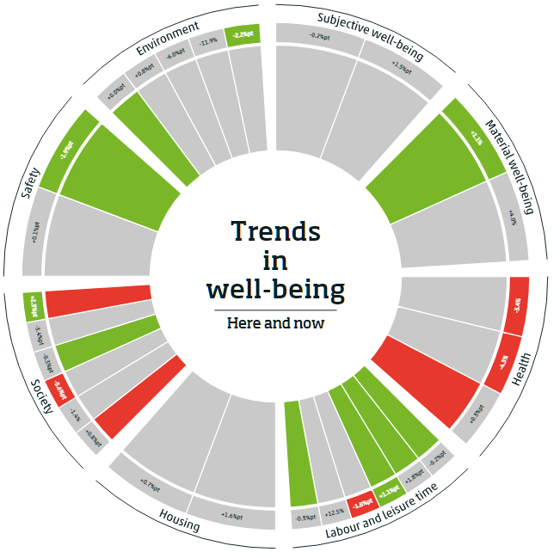
Example 1: Beyond GDP
Monitor on well-being and sustainable development goals
Requested by House of Representatives
200 indicators:
economy, environment, society / here and now, later, elsewhere
Problem
Not all indicators are T-1 (can be T-2 of T-3)
Objective
More current indicators through acceleration of processes and methodological solutions
Solution
Nowcasting framework for various types of indicators.
Publication since 2019
https://www.cbs.nl/en-gb/dossier/dossier-well-being-and-the-sustainable-development-goals
45

Slide 46
Approach
Method:
compare several models (Univariate STM’s, ARIMA, naïve) with auxiliary variables
‘automatic’ model and variable selection based on RMSE / ME
Acceptance criteria:
Accelerating process possible? Use partial data?
Sufficient time series data
Auxiliary data
Model type of best model
Selection based on combination of RMSE and ME
Realisations within 95% forecast interval
Plausibility check
46

Slide 47
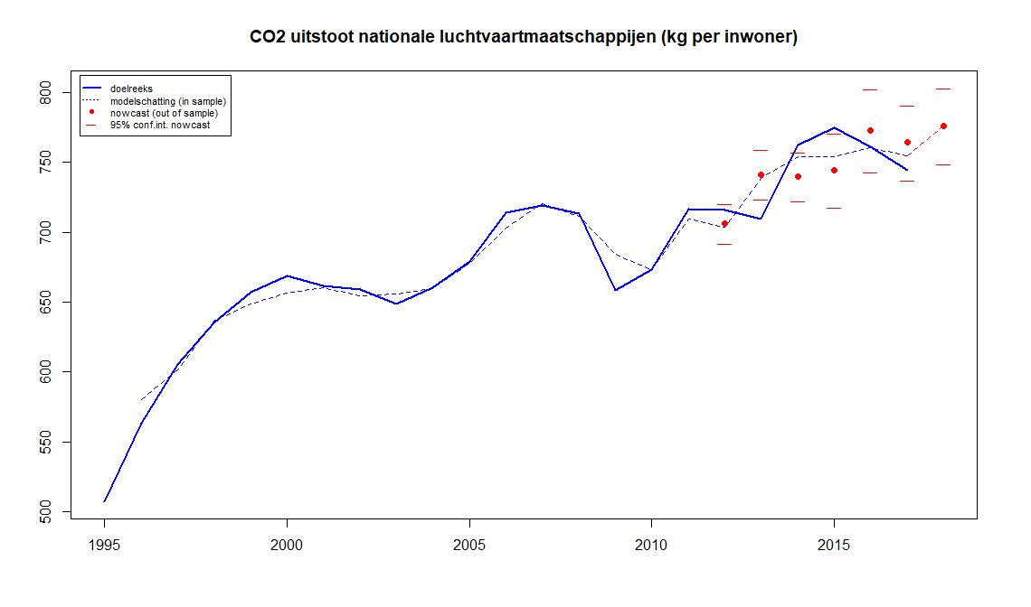
CO2 emissions of national airlines
Fitting
Holdout

Slide 48
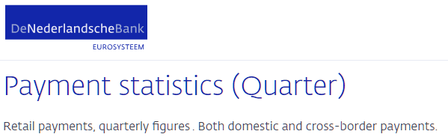
Example 2: Banking sector
Component of GDP
Hardly any data when producing Flash estimate
Current method
T-1 (naive) method + expert judgement based on payment data
Solution
Use payment data of Dutch Central Bank to make a nowcast for volume index
Taking into account data vintages during cross validation
Used in production since 2018
48

Slide 49
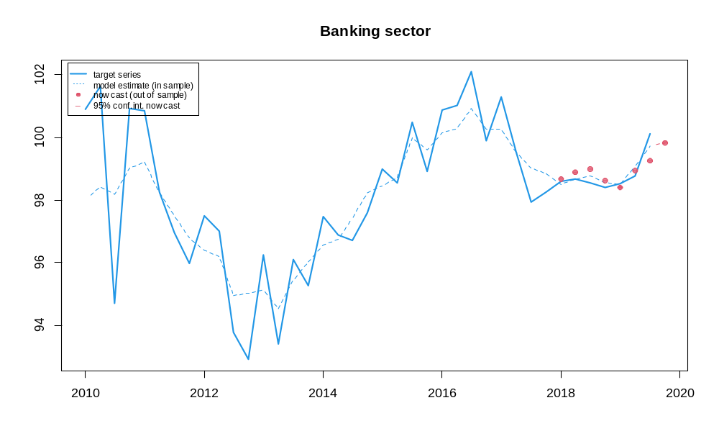
Results
Variables used:
Payment transactions:
  Debitcard
  Creditcard domestic
  Creditcard foreign
  Cash deposits
  Total payment transactions
Mortgages
Euribor interest rate
49

